Slide 1
Capstone Engagement
Assessment, Analysis, and Hardening of a Vulnerable System

Slide 2
Table of Contents
This document contains the following sections:
01
Network Topology
02
Red Team: Security Assessment
03
Blue Team: Log Analysis and Attack Characterization
Hardening: Proposed Alarms and Mitigation Strategies
04

Slide 3
Network Topology
‹#›

Slide 4
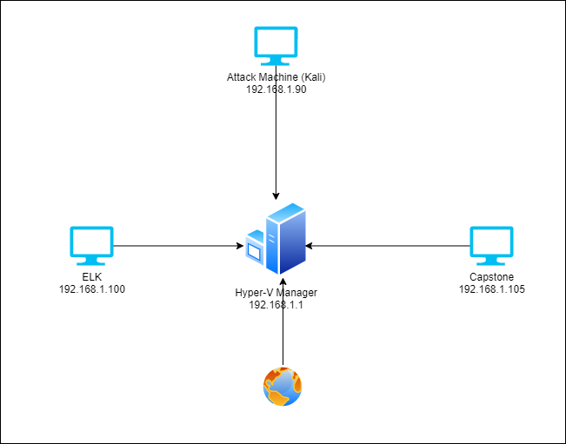
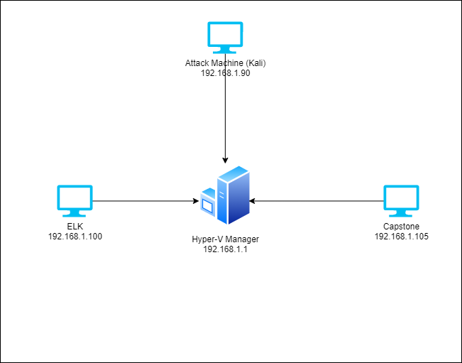
Network Topology
[Insert Here]
Use draw.io to create a diagram of the network.
Add your diagram to this slide and fill out the data in the sidebar.
Network
Address Range:192.168.1.0/24
Netmask:
Gateway:
Machines
IPv4:192.168.1.1
OS: Windows XP SP2
Hostname: HyperV
IPv4: 192.168.1.100
OS: Linux
Hostname:ELK
IPv4: 192.168.1.105
OS: Linux
Hostname: Capstone
IPv4: 192.168.1.90
OS: Linux
Hostname: Kali

Slide 5

Red Team
Security Assessment
‹#›

Slide 6
Recon: Describing the Target
Nmap identified the following hosts on the network:
Hostname | IP Address | Role on Network
Hyper-V | 192.168.1.1 | Network
Server One | 192.168.1.105 | Apache web server
ELK | 192.168.1.100 | ELK Stack
Kali | 192.168.1.90 | Attack machine

Slide 7
Vulnerability Assessment
The assessment uncovered the following critical vulnerabilities in the target:
Vulnerability | Description | Impact
Weak passwords/exposed credentials | Openly available credentials and passwords are not secure | Allowed threat actors to invade network and procure sensitive data.
SSH password | Access to network via a remote machine with weak credentials (no handshake) | Allows unfiltered access to web server.
Open ports | Non-serviced ports exposed | Allows threat actors to exploit any and all vulnerabilities that are not being used.
Hydra brute force attack | Brute force attack to gain access | Allows external threats to attempt as many logins as needed to gain access to your network

Slide 8
Exploitation: [Reverse_tcp shell]
01
02
Tools & Processes
How did you exploit the vulnerability? Which tool (Nmap, etc.) or techniques (XSS, etc.) did you use?
1.Nmap
2.Hydra Brute force attack
3.Hash Cracker
4.msfvenom
5.metasploit
Achievements
What did the exploit achieve? For example: Did it grant you a user shell, root access, etc.?
Access was achieved via a reverse_tcp payload that was injected in the host machine.

Slide 9
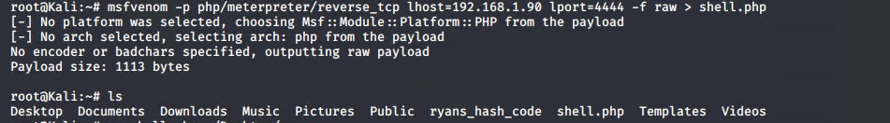
Exploitation: [Reverse_tcp shell]
03

Slide 10
Exploitation: [Brute Force Attack]
01
02
Tools & Processes
How did you exploit the vulnerability? Which tool (Nmap, etc.) or techniques (XSS, etc.) did you use?
1.Nmap
2.Hydra Brute force attack
Achievements
What did the exploit achieve? For example: Did it grant you a user shell, root access, etc.?
Was able to gain access through brute force attack and sign in as a company user

Slide 11
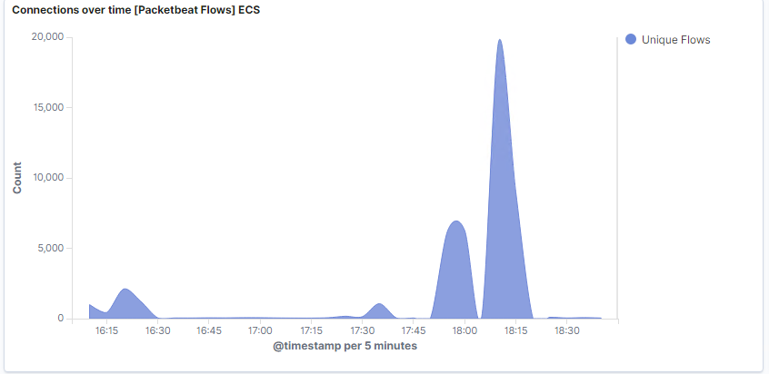
Exploitation: [Brute Force Attack]
03

Slide 12
Exploitation: [ssh]
01
02
Tools & Processes
How did you exploit the vulnerability? Which tool (Nmap, etc.) or techniques (XSS, etc.) did you use?
1.Nmap
2.John the Ripper
3. ssh
Achievements
What did the exploit achieve? For example: Did it grant you a user shell, root access, etc.?
Allowed attacker to remote in as user and allow to browse and read most files on server.

Slide 13
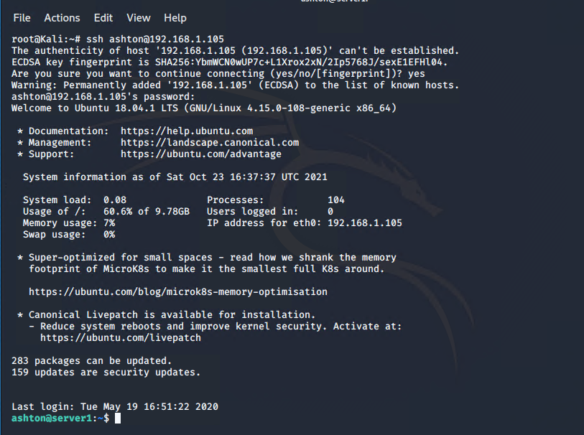
Exploitation: [ssh]
03

Slide 14

Blue Team
Log Analysis and Attack Characterization
‹#›

Slide 15

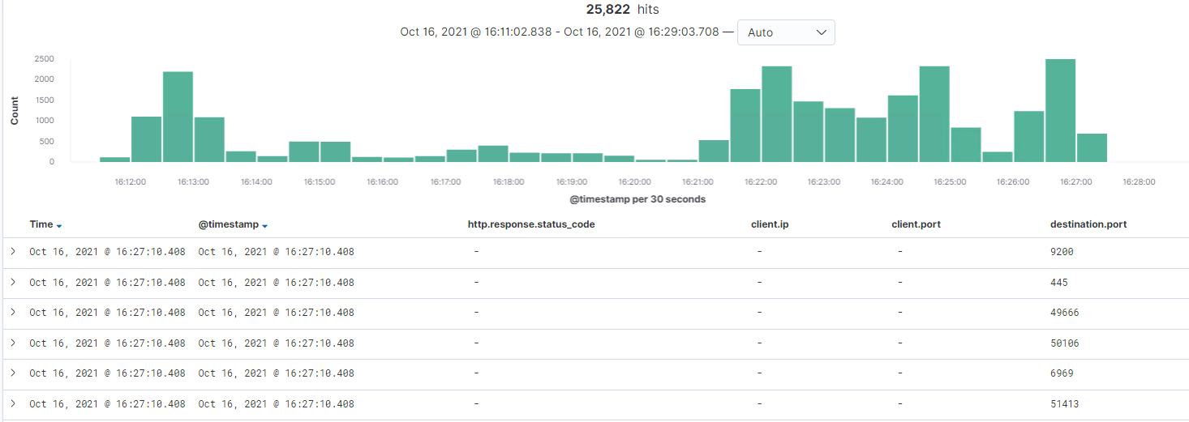
Analysis: Identifying the Port Scan
What time did the port scan occur? 10/16/21 at 16:27
How many packets were sent, and from which IP? 25822 packets were sent from 192.168.1.90
What indicates that this was a port scan? Numerous different destination ports listed in report is a tell-tale sign of port scan

Slide 16
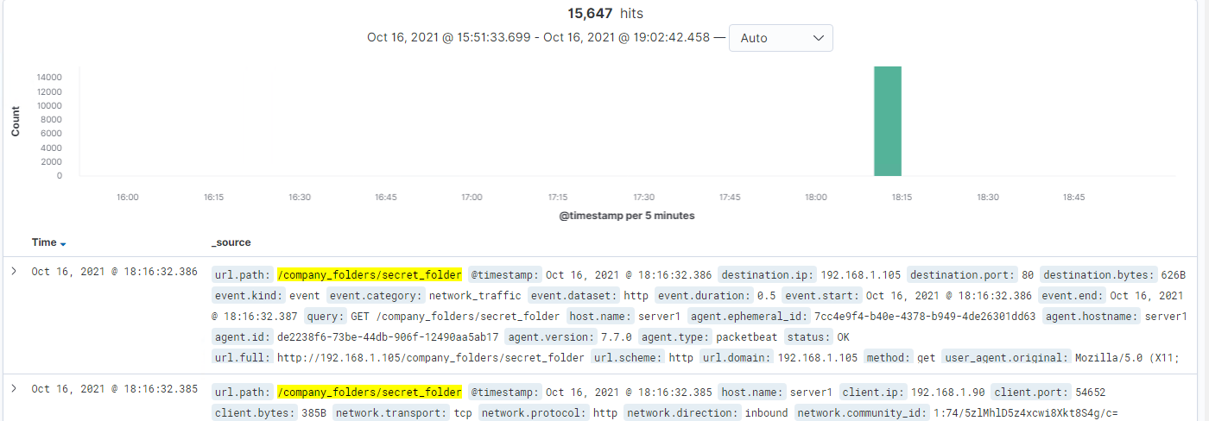
Analysis: Finding the Request for the Hidden Directory
What time did the request occur? 10/16/21 at 18:16 How many requests were made? 15647
Which files were requested? What did they contain? The secret company file which had login information and a vulnerable file path to Webdav.
[Insert Here]
Include a screenshot of Kibana logs depicting the request for the hidden directory.

Slide 17
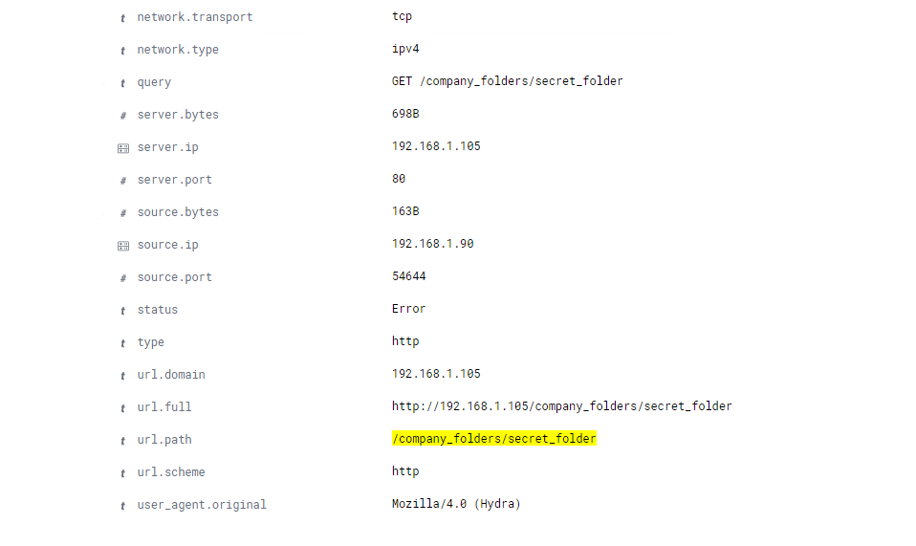
Analysis: Uncovering the Brute Force Attack
How many requests were made in the attack? 95712
How many requests had been made before the attacker discovered the password? Around 93000

Slide 18
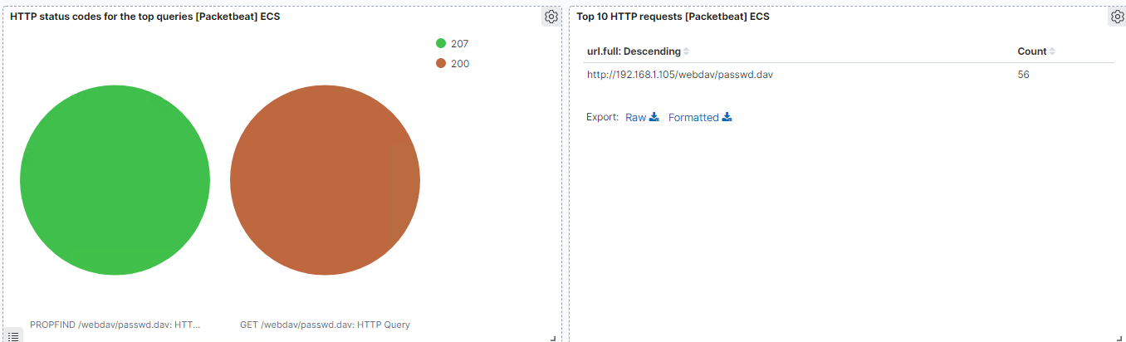
Analysis: Finding the WebDAV Connection
Our Team found that we had made 56 requests to the /webdav/passwd.dav file which was used to infiltrate the capstone network.
[Insert Here]
Add a screenshot of Kibana logs depicting the WebDAV connection.

Slide 19
Blue Team
Proposed Alarms and Mitigation Strategies
‹#›

Slide 20
Mitigation: Blocking the Port Scan
What configurations can be set on the host to mitigate port scans?
Closing all unused ports
Block all port scans
Firewall
Describe the solution. If possible, provide required command lines.
By denying all port scans and closing all unused ports we remove a lot of potential risk and information that can be used to attack our network.
What kind of alarm can be set to detect future port scans?
Set alert to flag any activity on ports that unused/closed
What threshold would you set to activate this alarm?
This alert should be triggered anytime we have activity on the ports

Slide 21
Mitigation: Finding the Request for the Hidden Directory
What kind of alarm can be set to detect future unauthorized access?
A surge of 401 HTTP status codes for hidden directory
White Listing IP addresses
What threshold would you set to activate this alarm?
5 attempts in a minute should trigger the alarm
What configuration can be set on the host to block unwanted access?
White-list IP addresses for access
Monitor and lock accounts after too many failed login attempts
Describe the solution. If possible, provide required command lines.
By whitelisting IPs it ensure outside attackers can’t just log in from anywhere and by locking accounts it would make it so if someone spoofed ip addresses they are still limited in their attempts to breach

Slide 22
Mitigation: Preventing Brute Force Attacks
What configuration can be set on the host to block brute force attacks?
Locking out account with too many failed logins
Required to have secure passwords that rotate on a quarterly basis
Describe the solution. If possible, provide the required command line(s).
Locking accounts after too many attempt helps prevent brute force attacks. Rotating passwords helps make sure that logins don’t stay stale long enough for someone to figure them out. Highly recommend training all employees on cyber security as well.
What kind of alarm can be set to detect future brute force attacks?
Failed logins attempts
What threshold would you set to activate this alarm?
20 failed logins in a minute timeframe

Slide 23
Mitigation: Detecting the WebDAV Connection
What kind of alarm can be set to detect future access to this directory?
WebDAV access control (any external access or anything written should set off a flag)
What threshold would you set to activate this alarm?
Any attempt to write to the WebDav file
What configuration can be set on the host to control access?
Lock down WebDAV services to not allow files to be access and written to.
Describe the solution. If possible, provide the required command line(s).
If you can’t write to that remote tool it prevents the reverse shell exploitation from happening.

Slide 24
Mitigation: Identifying Reverse Shell Uploads
What kind of alarm can be set to detect future file uploads?
Outbound traffic on any port that does not have a known service allocated to it.
Alert for .php files
What threshold would you set to activate this alarm?
Any
What configuration can be set on the host to block file uploads?
Block ability to write files in certain directories.
Prevent file upload
Describe the solution. If possible, provide the required command line.
Limiting users ability to write and upload file will insure this will be prevented. Possibly firewall or anti-virus software

